Slide 1
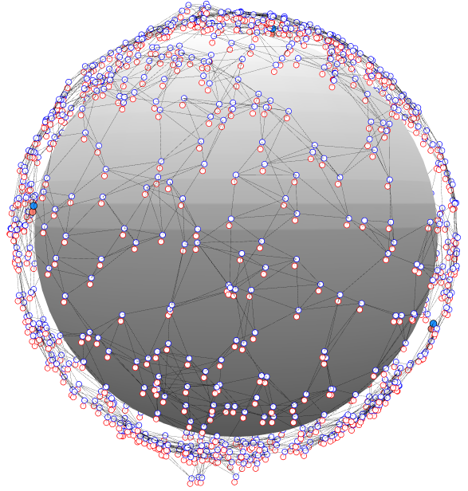
Chain Mail DiAL – Distributed Ad-Hoc Localization
Rapid and distributed position estimation in large proliferated constellations
Justin Kim
841753
Scrimmage
15
Report + hardware implementation
DiAL is for rapidly determining satellite position in a large proliferated constellation, addressing a challenge for future constellation operators.
A distributed localization algorithm will use crosslink information to relatively map the network and use anchor nodes to absolutely map the network, without large computational overhead or a centralized computing system.
Propose terms for 3 sprints. Describe the goals of each sprint and what will be demonstrated
Sprint 1: Investigate and characterize range-free algorithm, ranging uncertainty, network topology effects. Begin collaboration with other teams for hardware implementation.
Sprint 2: Implement and test algorithms on SWaP-limited hardware.
Sprint 3: Document results in ATM or ATR. Look for publication opportunities.

